Slide 1
Final Project
Socioeconomic Factors and Obesity: A US nation/State-Level Analysis
Elaine Da Silva & Tiankun Deng

Slide 2

Datasets Analyzed
Small Dataset | Big Dataset
Nutrition_Physical_Activity_and_Obesity 104,272 rows 33 columns 34,934 kb 2011-2023 year | yellow_tripdata_2015-01 12,748,986 rows 19 columns 1,939,986 kb
Datasets

Slide 3
Table of Contents
01
03
Introduction
Conclusion
02
04
Analysis & Insights
Reference

Slide 4
01
Introdution

Slide 5
Introduction
Background:
Obesity is a growing public health issue in the U.S. linked to socioeconomic and lifestyle factors.
Data comes from BRFSS, focusing on diet, physical activity, and weight trends.
Purpose:
Analyze how socioeconomic factors influence obesity.
Explore nation/state-level variations in obesity and related behaviors.

Slide 6






Methodology
Function, Loop, Conditionals
Plots(visualization)
Read from & Write
to csv files
Numpy Array
Pandas DataFrame
Pandas vs Spark comparison

Slide 7



Key Metrics
Obesity/Overweight
Physical Activity
Vegetable/Fruit Consumption

Slide 8
Raw Data

Slide 9
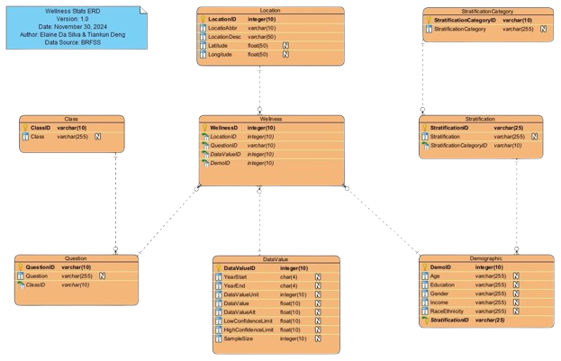
ERD

Slide 10
Data Dictionary

Slide 11
02
Analysis & Insights

Slide 12


Questions
How does income influence food consumption patterns in the United States over the years?
Q1
Function, Loop, Conditionals, Read from csv files
Average percentage for skipping fruit in Low Income: 42.32%
Average percentage for skipping vegetables in Low Income: 29.60%
Average percentage for skipping fruit in Medium Income: 39.33%
Average percentage for skipping vegetables in Medium Income: 20.44%
Average percentage for skipping fruit in High Income: 35.70%
Average percentage for skipping vegetables in High Income: 14.37%

Slide 13
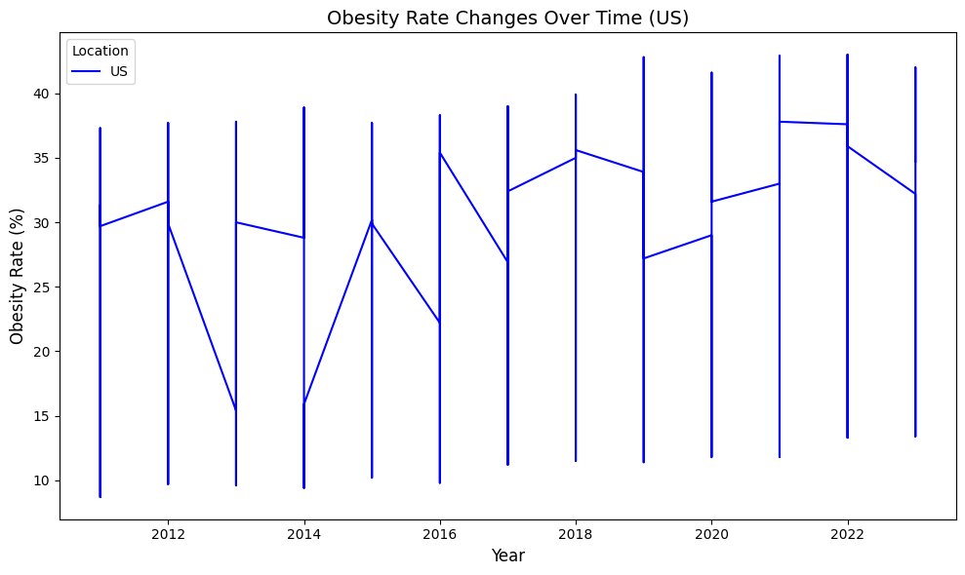

Questions
What is the average obesity rate across the United States over the years?
Q2
Numpy Array & Related Functions
Statistical Analysis of Obesity Rates (US):
Mean Obesity Rate: 30.64%
Standard Deviation: 6.30%
Maximum Obesity Rate: 43.00%
Minimum Obesity Rate: 8.70%
Median Obesity Rate: 31.80%

Slide 14
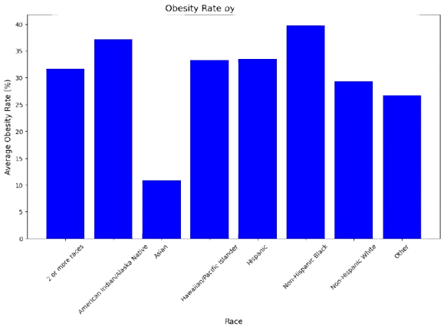

Questions
Q3
What is the relationship between obesity rates and race in the United States?
Pandas Dataframe & Related Functions

Slide 15
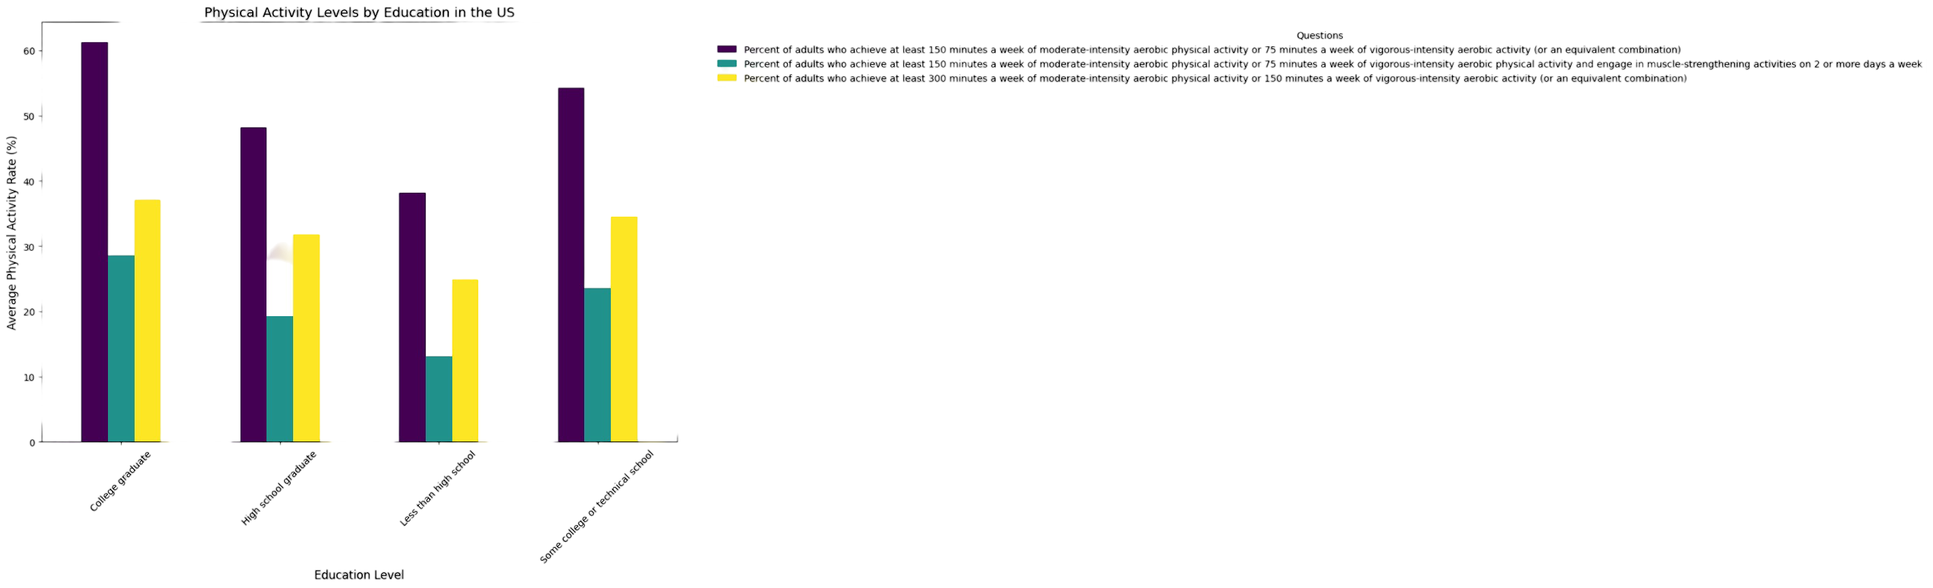

Questions
What is the relationship between education levels and physical activity rates nationally?
Q4

Slide 16
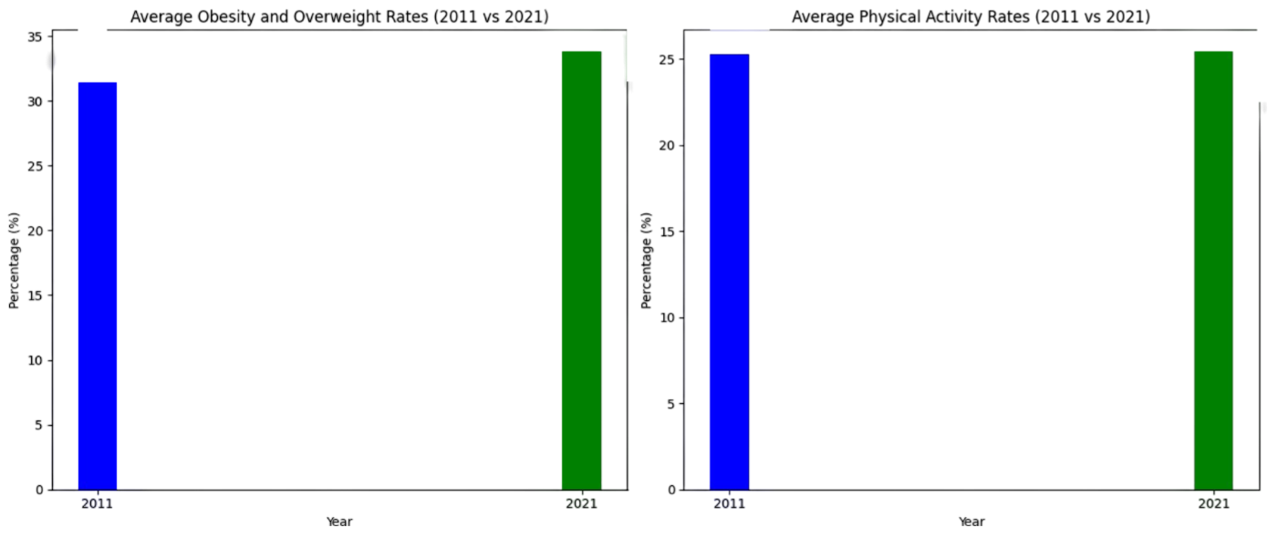

Questions
What are the average obesity/overweight rates and physical activity rates in 2011 compared to 2021?
Q5

Slide 17
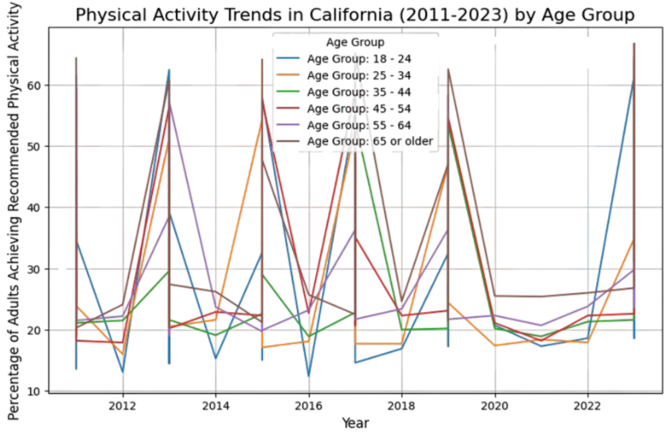

Questions
In California, how has physical activity participation changed across different age groups over the years?
Q6

Slide 18

Questions
How do obesity and physical activity participation differ between genders in California in 2023?
Q7
Obesity by Gender
Female 28.55
Male 35.35
Physical Activity by Gender:
Female 37.64
Male 41.86

Slide 19
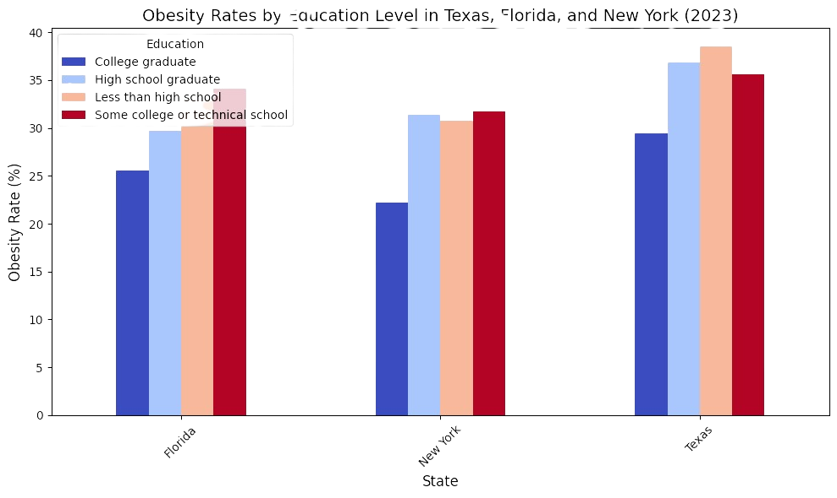

Questions
How do obesity rates in the U.S. correlate with educational attainment levels in Texas, Florida, and New York?
Q8

Slide 20

Questions
How do muscle-building exercise compare across Texas, Florida, and New York?
Q9
Florida
Female 39.3
Male 48.4
New York
Female 38.3
Male 45.7
Texas
Female 38.2
Male 47.8

Slide 21


Questions
Which are the top and bottom three US states in terms of obesity rates, physical activity levels, and fruit and vegetable consumption?
Q10
West Virginia
35.49
Louisiana
34.82
Mississippi
35.46
Hawaii
29.64
Colorado
29.16
DC
27.87
=== Weight-related Issues ===

Slide 22
Questions
Which are the top and bottom three US states in terms of obesity rates, physical activity levels, and fruit and vegetable consumption?
Q10
Montana 35.19
Florida
35.08
Puerto Rico
35.11
Pennsylvania 31.99
North Carolina
31.98
Utah
31.64
=== Physical Activity-related Matters ===

Slide 23
Questions
Which are the top and bottom three US states in terms of obesity rates, physical activity levels, and fruit and vegetable consumption?
Q10
Vermont
24.38
New Hampshire
25.62
Maine
24.67
Puerto Rico
48.60
Louisiana
36.21
Guam 35.95
=== Food-related Questions===

Slide 24
Pandas vs PySpark: datasets information
Small dataset
Nutrition_Physical_Activity_and_Obesity.csv
Rows: 104,272
Columns: 33
Size: 34,934Kb
Big dataset
Yellow_tripdata_2015-01.csv
Rows: 12,748,986
Columns: 19
Size: 1,939,419Kb

Slide 25
Pandas vs Spark: time and memory consumption
Pandas - small
Spark - small
Pandas - big
Spark - big
Pandas: Data loaded: 0.53 seconds, Memory: 32.95 MB
Pandas: Filter operation: 0.13 seconds, Memory: 6.57 MB
Pandas: Aggregation: 0.00 seconds, Memory: 0.41 MB
Spark: Data loaded: 0.39 seconds, Memory: 0.00 MB
Spark: Filter operation: 0.15 seconds, Memory: 0.08 MB
Spark: Aggregation: 0.34 seconds, Memory: 0.00 MB
Pandas: Data loaded: 47.67 seconds, Memory: 3104.45 MB
Pandas: Filter operation: 2.63 seconds, Memory: 397.64 MB
Pandas: Aggregation: 0.08 seconds, Memory: 2.20 MB
Spark: Data loaded: 32.62 seconds, Memory: -3119.31 MB
Spark: Filter operation: 0.42 seconds, Memory: -407.30 MB
Spark: Aggregation: 8.37 seconds, Memory: 2.21 MB

Slide 26
03
Conclusion

Slide 27
US Obesity Analysis Conclusion
Higher-income groups tend to have healthier dietary habits, though this varies regionally.
The average obesity rate in the U.S. is 30.64%, with a standard deviation of 6.3%, indicating significant state-level variation.
Certain racial groups exhibit higher obesity rates, highlighting the influence of socioeconomic and cultural factor
Individuals with higher education levels are more likely to engage in physical activities.
Obesity and physical activity rates have shown slight changes over the past decade(2011 vs 2021) with state-level trends varying.
In California (2023), men slightly outperform women in physical activity participation, but with higer obesity rates
In Texas, Florida, and New York, higher educational attainment is inversely correlated with obesity rates, with notable differences among the states.
Strength Training Across Texas, Florida, and New York varies significantly among these states.
The top and bottom states in obesity, physical activity, and dietary habits reveal strong correlations between lifestyle choices and health outcomes.

Slide 28
Pandas vs Spark: conclusion
Small dataset
Overall, Spark is more memory-efficient in all operations.
Spark is more optimized for loading.
Pandas is more efficient at aggregating data.
Big dataset
Spark is more memory-efficient for loading and filtering. And similar to Pandas for aggregating.
Spark is more optimized for loading and filtering.
Pandas is more efficient at aggregating data

Slide 29
04
Reference

Slide 30
References
Data.gov. (2023, December 8). U.S. Department of Health & Human Services - Nutrition, Physical Activity, and Obesity - Behavioral Risk Factor Surveillance System. Retrieved December 1, 2024, from https://catalog.data.gov/dataset/nutrition-physical-activity-and-obesity-behavioral-risk-factor-surveillance-system
Nutrition, physical activity, and obesity - Behavioral Risk Factor Surveillance System | Data | Centers for Disease Control and Prevention. (2024, October 7). Retrieved December 1, 2024, from https://chronicdata.cdc.gov/Nutrition-Physical-Activity-and-Obesity/Nutrition-Physical-Activity-and-Obesity-Behavioral/hn4x-zwk7/about_data
NYC yellow taxi trip data. (2021, December 9). Kaggle. Retrieved December 4, 2024, from https://www.kaggle.com/datasets/elemento/nyc-yellow-taxi-trip-data
Functions — PySpark 3.5.3 documentation. (n.d.). Retrieved December 3, 2024, from https://spark.apache.org/docs/latest/api/python/reference/pyspark.sql/functions.html
Nelamali, N. (2024, October 1). Pandas vs PySpark DataFrame With Examples. Spark by {Examples}. https://sparkbyexamples.com/pyspark/pandas-vs-pyspark-dataframe-with-examples/

